Slide 1
Chongqing University of Technology
ATAI
Advanced Technique of Artificial Intelligence
Chongqing University of Technology
Meta Label Correction for Noisy Label Learning（AAAI 2021 ）
彭展望
Code: https://github.com/microsoft/MLC

Slide 2
Outline
Introduction
Related Work
Method
Experiment
Conclusion

Slide 3
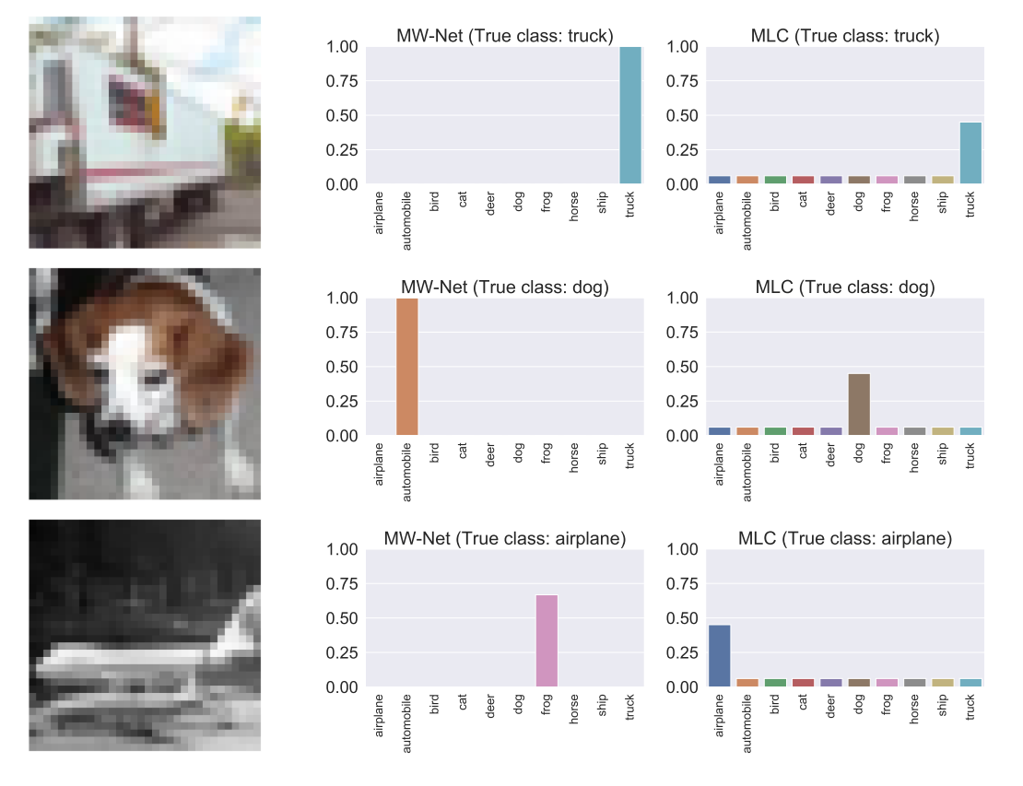
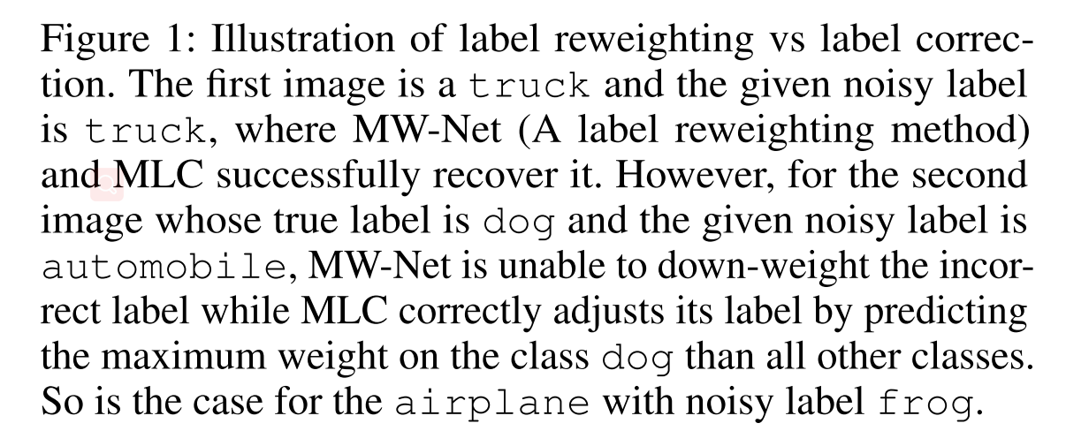
Introduction
MW-Net Meta-Weight-Net: Learning an Explicit Mapping For Sample Weighting（ NeurIPS 2019 ）

Slide 4
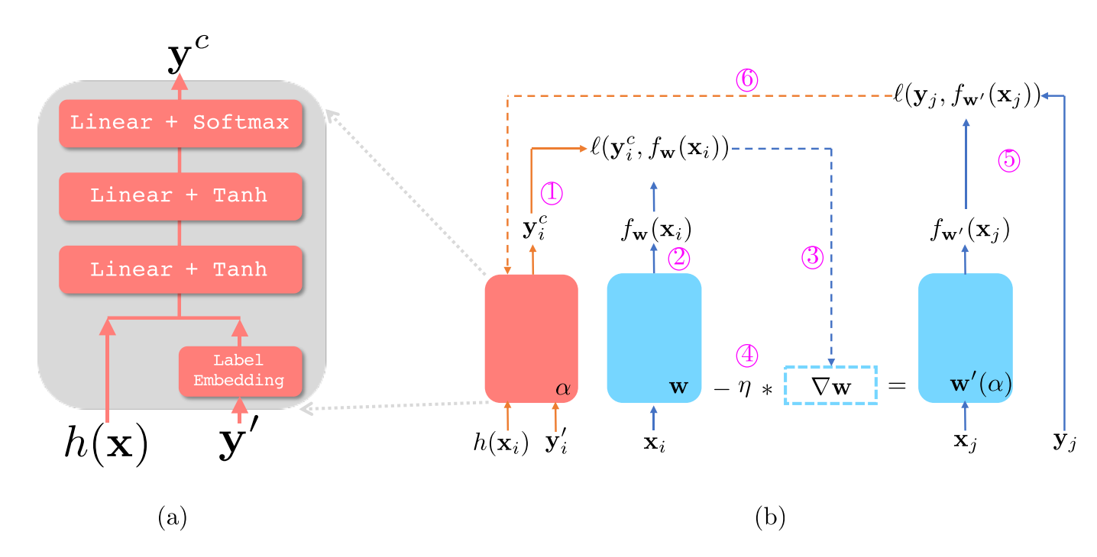
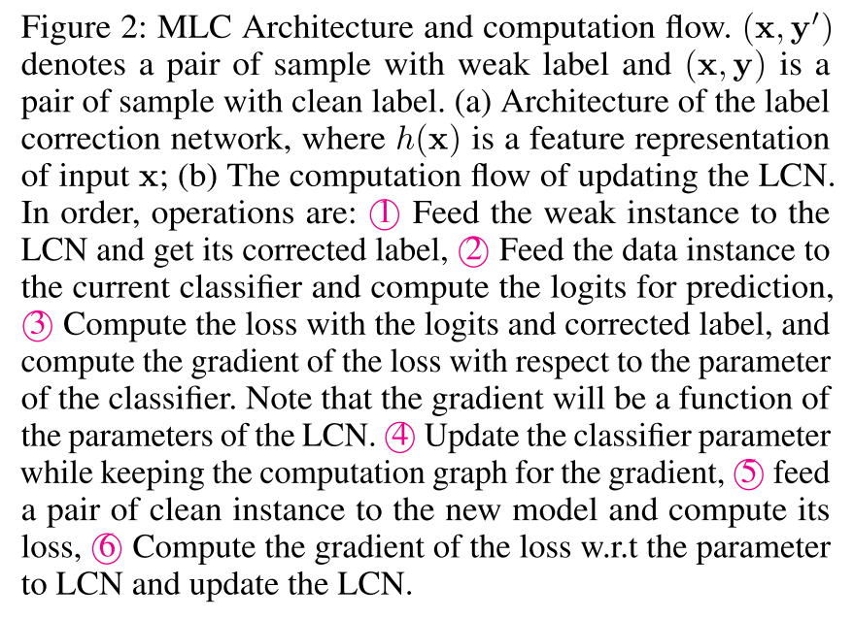
Method

Slide 5
Method

Slide 6
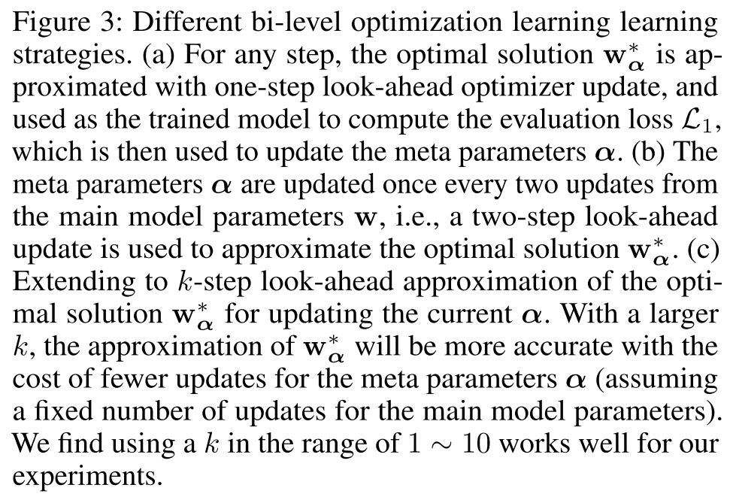

Slide 7
Method

Slide 8
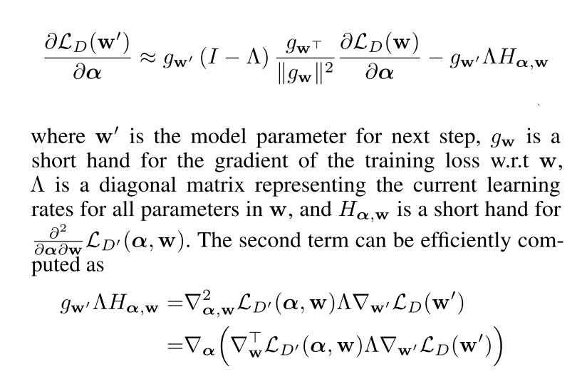
Method

Slide 9
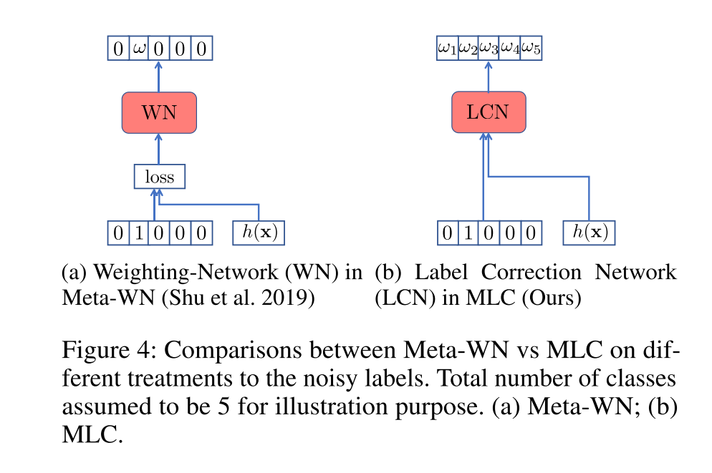
Notes:
$$z=mean−pooling(H^{L})$$

Slide 10
Dataset

Slide 11
Experiment

Slide 12
Experiment

Slide 13
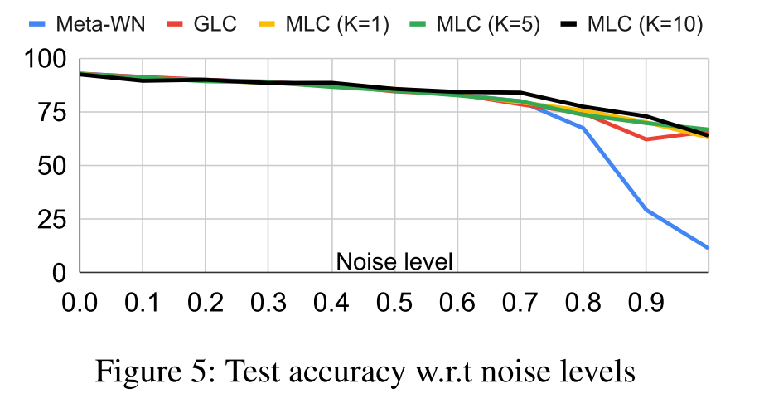
Experiment

Slide 14
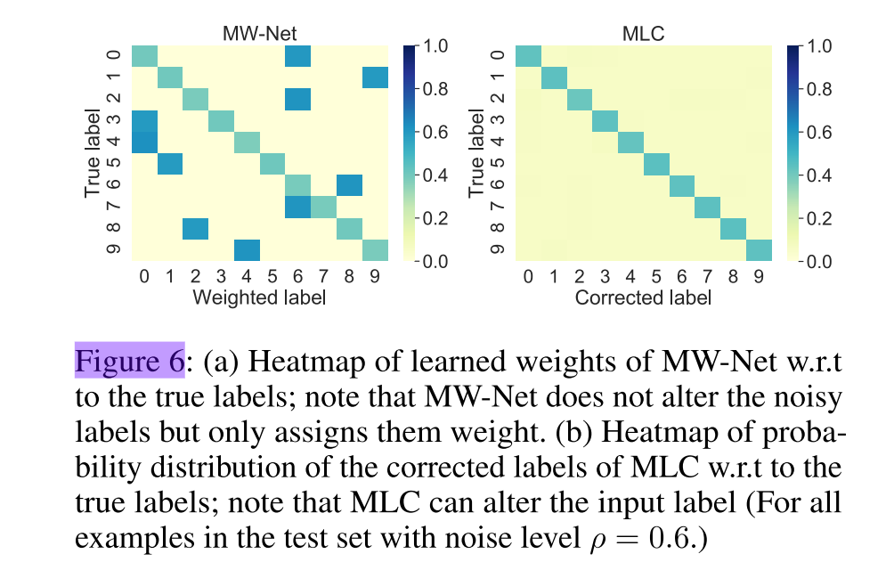
Experiment

Slide 15
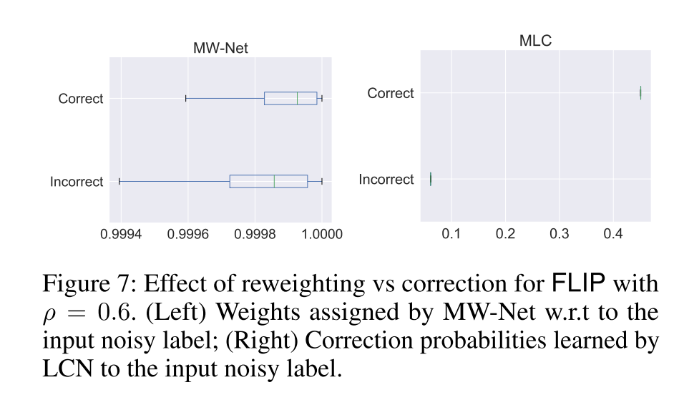
Experiment

Slide 16
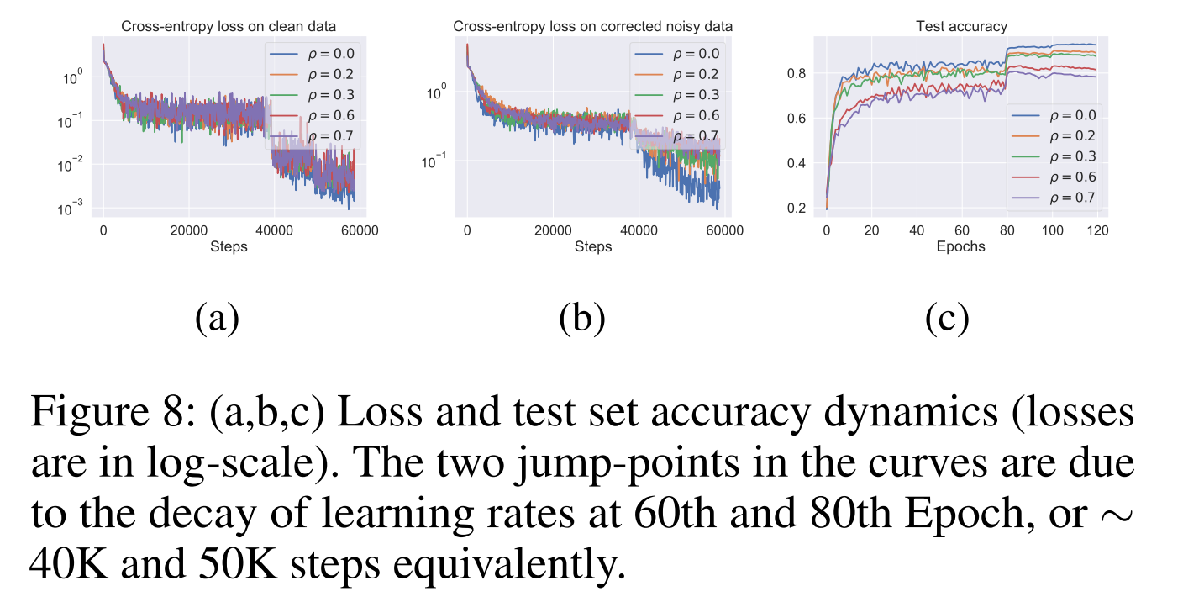
Experiment

Slide 17
Thanks

